Slide 1
A Survey of Probability Concepts
5

Slide 2
GOALS
Define probability.
Describe the classical, empirical, and subjective approaches to probability.
Explain the terms experiment, event, outcome, permutations, and combinations.
Define the terms conditional probability and joint probability.
Calculate probabilities using the rules of addition and rules of multiplication.
Apply a tree diagram to organize and compute probabilities.
Calculate a probability using Bayes’ theorem.

Slide 3
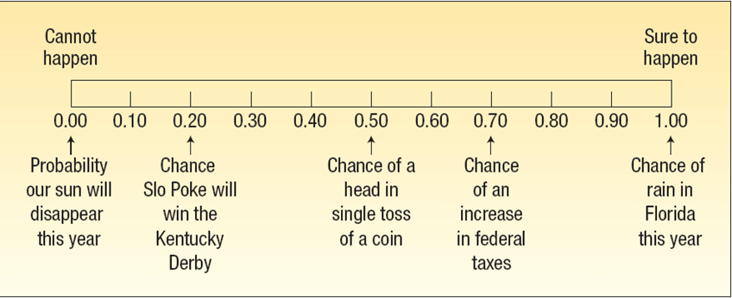
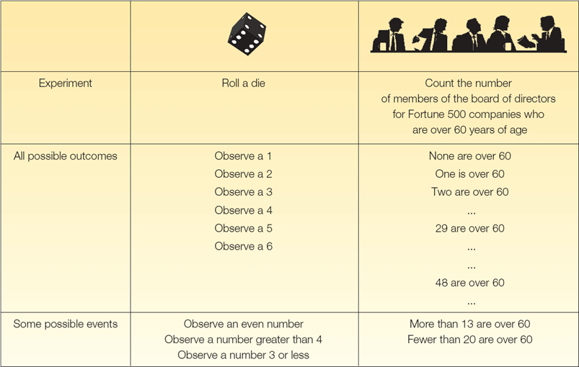
Probability, Experiment, Outcome, Event: Defined
PROBABILITY A value between zero and one, inclusive, describing the relative possibility (chance or likelihood) an event will occur.
An experiment is a process that leads to the occurrence of one and only one of several possible observations.
An outcome is the particular result of an experiment.
An event is the collection of one or more outcomes of an experiment.

Slide 4
Mutually Exclusive Events and
Collectively Exhaustive Events
Events are mutually exclusive if the occurrence of any one event means that none of the others can occur at the same time.
Events are collectively exhaustive if at least one of the events must occur when an experiment is conducted.
The sum of all collectively exhaustive and mutually exclusive events is 1.0 (or 100%)
Events are independent if the occurrence of one event does not affect the occurrence of another.
collectively exhaustive and mutually exclusive events

Slide 5
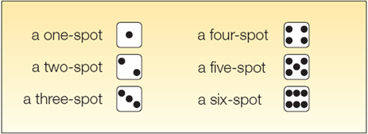
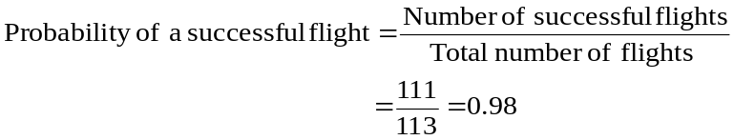
Classical and Empirical Probability
Consider an experiment of rolling a six-sided die. What is the probability of the event “an even number of spots appear face up”?
The possible outcomes are:
There are three “favorable” outcomes (a two, a four, and a six) in the collection of six equally likely possible outcomes.
The empirical approach to probability is based on what is called the law of large numbers. The key to establishing probabilities empirically is that more observations will provide a more accurate estimate of the probability.
EXAMPLE:
On February 1, 2003, the Space Shuttle Columbia exploded. This was the second disaster in 113 space missions for NASA. On the basis of this information, what is the probability that a future mission is successfully completed?

Slide 6

Subjective Probability - Example
If there is little or no past experience or information on which to base a probability, it may be arrived at subjectively.
Illustrations of subjective probability are:
  1. Estimating the likelihood the New England Patriots will play in the Super Bowl next year.
  2. Estimating the likelihood you will be married before the age of 30.
  3. Estimating the likelihood the U.S. budget deficit will be reduced by half in the next 10 years.

Slide 7
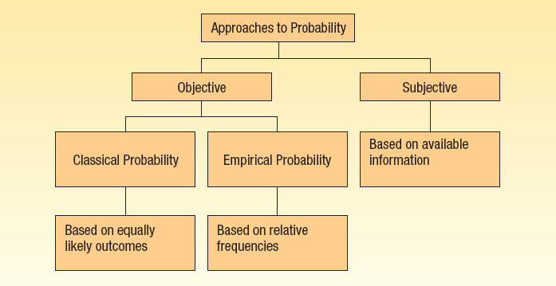
Summary of Types of Probability

Slide 8
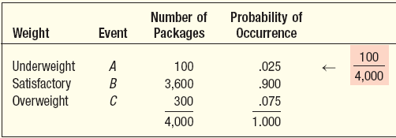
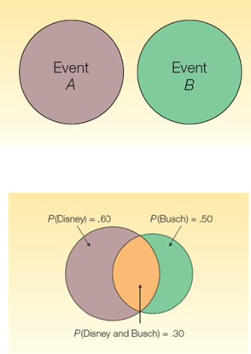
Rules of Addition
Rules of Addition
Special Rule of Addition - If two events A and B are mutually exclusive, the probability of one or the other event’s occurring equals the sum of their probabilities.
P(A or B) = P(A) + P(B)
The General Rule of Addition - If A and B are two events that are not mutually exclusive, then P(A or B) is given by the following formula:
P(A or B) = P(A) + P(B) - P(A and B)
EXAMPLE:
An automatic Shaw machine fills plastic bags with a mixture of beans, broccoli, and other vegetables. Most of the bags contain the correct weight, but because of the variation in the size of the beans and other vegetables, a package might be underweight or overweight. A check of 4,000 packages filled in the past month revealed:
What is the probability that a particular package will be either underweight or overweight?
P(A or C) = P(A) + P(C) = .025 + .075 = .10

Slide 9
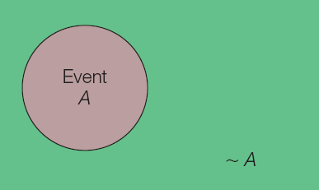
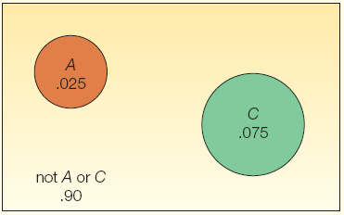
The Complement Rule
The complement rule is used to determine the probability of an event occurring by subtracting the probability of the event not occurring from 1.
P(A) + P(~A) = 1
or P(A) = 1 - P(~A).
EXAMPLE
An automatic Shaw machine fills plastic bags with a mixture of beans, broccoli, and other vegetables. Most of the bags contain the correct weight, but because of the variation in the size of the beans and other vegetables, a package might be underweight or overweight. Use the complement rule to show the probability of a satisfactory bag is .900
P(B) = 1 - P(~B)
= 1 – P(A or C)
= 1 – [P(A) + P(C)]
= 1 – [.025 + .075]
= 1 - .10
= .90

Slide 10
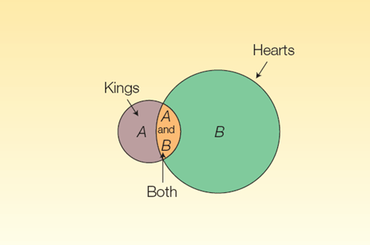
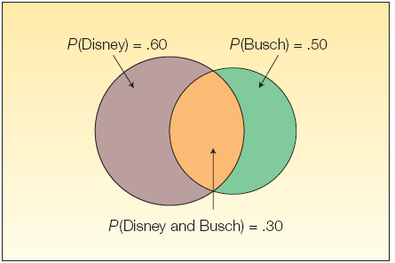
The General Rule of Addition and Joint Probability
The Venn Diagram shows the result of a survey of 200 tourists who visited Florida during the year. The survey revealed that 120 went to Disney World, 100 went to Busch Gardens and 60 visited both.
What is the probability a selected person visited either Disney World or Busch Gardens?
JOINT PROBABILITY A probability that measures the likelihood two or more events will happen concurrently.
P(Disney or Busch) = P(Disney) + P(Busch) - P(both Disney and Busch)
= 120/200 + 100/200 – 60/200
= .60 + .50 – .80

Slide 11
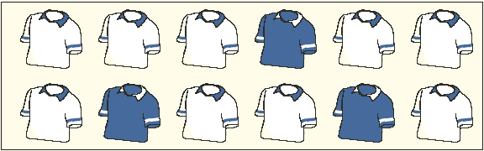
Special and General Rules of Multiplication
The special rule of multiplication requires that two events A and B are independent.
Two events A and B are independent if the occurrence of one has no effect on the probability of the occurrence of the other.
This rule is written: P(A and B) = P(A)P(B)
EXAMPLE
A survey by the American Automobile association (AAA) revealed 60 percent of its members made airline reservations last year. Two members are selected at random. Since the number of AAA members is very large, we can assume that R1 and R2 are independent. What is the probability both made airline reservations last year?
Solution:
The probability the first member made an airline reservation last year is .60, written as P(R₁) = .60
The probability that the second member selected made a reservation is also .60, so P(R₂) = .60.
Since the number of AAA members is very large, you may assume that R₁ and R₂ are independent.
P(R₁ and R₂) = P(R₁)P(R₂) = (.60)(.60) = .36
The general rule of multiplication is used to find the joint probability that two independent events will occur.
EXAMPLE
A golfer has 12 golf shirts in his closet. Suppose 9 of these shirts are white and the others blue. He gets dressed in the dark, so he just grabs a shirt and puts it on. He plays golf two days in a row and does not do laundry.
What is the likelihood both shirts selected are white?
The event that the first shirt selected is white is W₁. The probability is P(W₁) = 9/12
The event that the second shirt (W₂ )selected is also white. The conditional probability that the second shirt selected is white, given that the first shirt selected is also white, is
P(W₂ | W₁) = 8/11.
To determine the probability of 2 white shirts being selected we use formula: P(AB) = P(A) P(B|A)
P(W₁ and W₂) = P(W₁)P(W₂ |W₁) = (9/12)(8/11) = 0.55

Slide 12
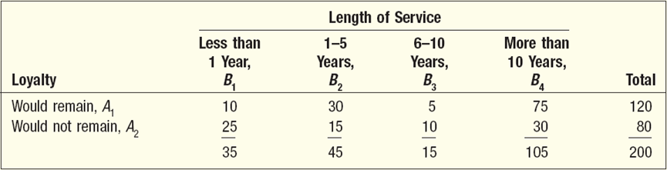

Contingency Tables
A CONTINGENCY TABLE is a table used to classify sample observations according to two or more identifiable characteristic
EXAMPLE:
A sample of executives were surveyed about their loyalty to their company. One of the questions was, “If you were given an offer by another company equal to or slightly better than your present position, would you remain with the company or take the other position?” The responses of the 200 executives in the survey were cross-classified with their length of service with the company. What is the probability of randomly selecting an executive who is loyal to the company (would remain) and who has more than 10 years of service?
Event A₁ happens if a randomly selected executive will remain with the company despite an equal or slightly better offer from another company. Since there are 120 executives out of the 200 in the survey who would remain with the company
P(A₁) = 120/200, or .60.
Event B₄ happens if a randomly selected executive has more than 10 years of service with the company. Thus, P(B₄| A₁) is the conditional probability that an executive with more than 10 years of service would remain with the company. Of the 120 executives who would remain 75 have more than 10 years of service, so
P(B₄| A₁) = 75/120.

Slide 13
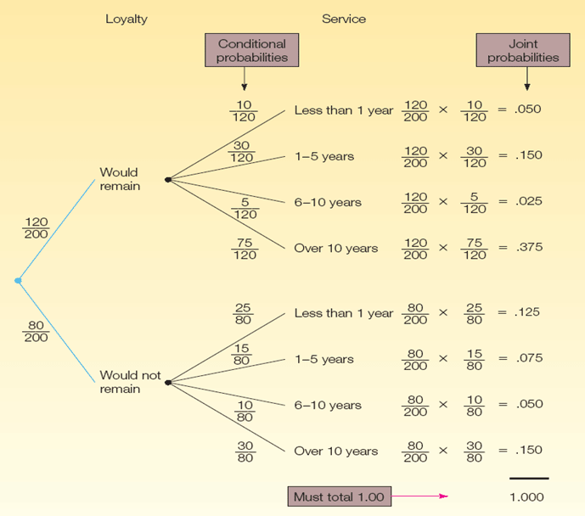
Tree Diagrams
A tree diagram is useful for portraying conditional and joint probabilities. It is particularly useful for analyzing business decisions involving several stages.
A tree diagram is a graph that is helpful in organizing calculations that involve several stages. Each segment in the tree is one stage of the problem. The branches of a tree diagram are weighted by probabilities.

Slide 14
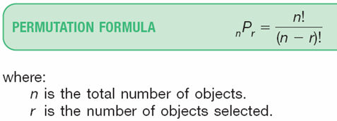

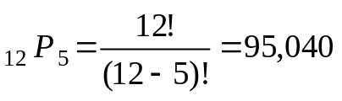
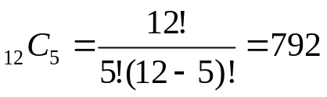
Permutation and Combination
A permutation is any arrangement of r objects selected from n possible objects. The order of arrangement is important in permutations.
EXAMPLE
Suppose that in addition to selecting the group, he must also rank each of the players in that starting lineup according to their ability.
A combination is the number of ways to choose r objects from a group of n objects without regard to order.
EXAMPLE
There are 12 players on the Carolina Forest High School basketball team. Coach Thompson must pick five players among the twelve on the team to comprise the starting lineup. How many different groups are possible?

